Slide 1


Database Systems
[ER Diagram Model in DBMS]

Slide 2
ER model stands for an Entity-
Relationship model.
It is a high-level data model. This model is used to define the data elements and relationship for a specified system.
It develops a conceptual design for the database.
It also develops a very simple and easy to design view of data.
In ER modeling, the database structure is portrayed as a diagram called an entity-relationship diagram.
ER (Entity Relationship) Diagram in DBMS

Slide 3
Suppose we design a school database.
In this database, the student will be an entity with attributes like address, name, id, age, etc.
The address can be another entity with attributes like city, street name, pin code, etc and there will be a relationship between them.
ERD in DBMS
id
name
address
age
student

Slide 4
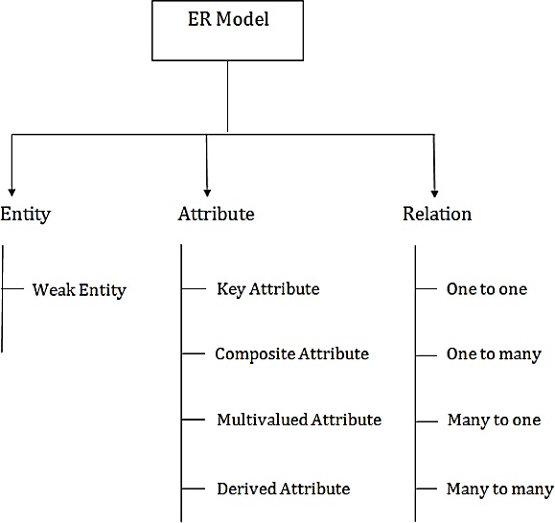
Component of ER Diagram

Slide 5

An entity may be any object, class, person or place. OR anything that is participating in the system.
In the ER diagram, an entity can be represented as rectangles.
Consider an organization as an example- manager, product, employee, department etc. can be taken as an entity.
Entity/ Object

Slide 6

An entity that depends on another entity called a weak entity.
The weak entity doesn't contain any
key attribute of its own.
The weak entity is represented by a
double rectangle.
Weak Entity

Slide 7
The attribute is used to describe the property (characteristics) of an entity. Eclipse is used to represent an attribute.
For example, id, age, contact number, name, etc. can be attributes of a student.
Attribute/ Properties
id
name
phone_no
age
student

Slide 8
Key Attribute
The key attribute is used to represent the main characteristics of an entity.
It represents a primary key.
The key attribute is represented by an ellipse with the text underlined.
id
name
phone_no
age
student

Slide 9
An attribute that composed of many other attributes is known as a composite attribute.
The composite attribute is represented by an ellipse, and those ellipses are connected with an ellipse.
Composite Attribute
name
First_name
Last_name
Middle_name

Slide 10
An attribute can have more than one value. These attributes are known as a multivalued attribute.
The double oval is used to represent multivalued attribute.
Multivalued Attribute
Phone_no

Slide 11
An attribute that can be derived from other attribute is known as a derived attribute.
It can be represented by a dashed ellipse.
For example, A person's age changes over time and can be derived from another attribute like Date of birth.
Derived Attribute
Birth_Date
name
roll_no
age
student

Slide 12
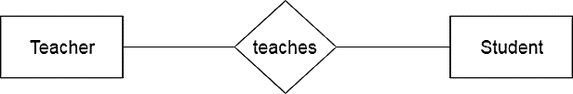
A relationship is used to describe the relation between entities. OR a logical connection between different entities.
The relationship indicates how the entities are connected or related to each other.
The entities that participate in a relationship are participants.
Diamond or rhombus is used to represent the relationship.
Relationship

Slide 13
A group of entities of the same type is called entity class.
All entities in an entity type share
common characteristics.
For example, STUDENT entity class is a collection all students.
A member of an entity class is also known as an entity instance.
For example, a student Abdullah of
STUDENT entity type is an entity instance.
Entity Class and Entity Instance

Slide 14
Many-to- Many Relationship
One-to-One
Relationship
Types of Relationship
Many-to- One Relationship
One-to- Many Relationship

Slide 15
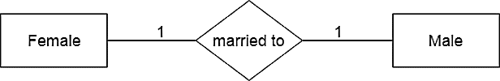
Types of Relationship (One-to-One Relationship)
When only one instance of an entity is associated with the relationship, then it is known as one to one relationship.
For example, A female can marry to one male, and a male can marry to one female.

Slide 16
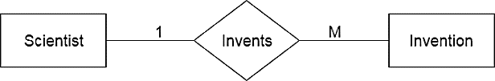
Types of Relationship (One-to-Many Relationship)
When only one instance of the entity on the left, and more than one instance of an entity on the right associates with the relationship then this is known as a one-to-many relationship.
For example, Scientist can invent many inventions, but the invention is done by the only specific scientist.

Slide 17
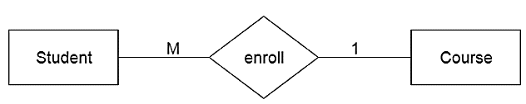
Types of Relationship (Many-to-One Relationship)
When more than one instance of the entity on the left, and only one instance of an entity on the right associates with the relationship then it is known as a many-to-one relationship.
For example, Student enrolls for only one course, but a course can have many students.

Slide 18
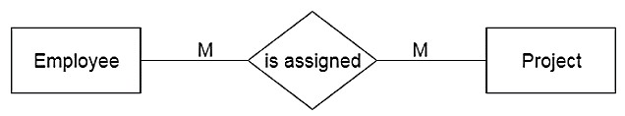
Types of Relationship (Many-to-Many Relationship)
When more than one instance of the entity on the left, and more than one instance of an entity on the right associates with the relationship then it is known as a many-to-many relationship.
For example, Employee can assign by many projects and project can have many employees.

Slide 19
The maximum number of instances of one entity associated with each instance of the related entity is known as cardinality.
The cardinality can be one or many.
Cardinality
The cardinality of one indicates single instance of an entity. The symbol of a vertical line | is used for one cardinality.
The cardinality of many indicates multiple instance of an entity. The symbol of a crow’s foot < is used for many cardinality.

Slide 20
The minimum number of instances of one entity associated with each instance of the related entity is known as modality.
It describes the relationship as
mandatory or optional.
The relationship is called optional
when the minimum number is zero.
The small circle o is used to indicate an optional relationship.
The relationship is called mandatory when the minimum number is one.
The vertical line | is used to indicate a mandatory relationship.
Modality

Slide 21
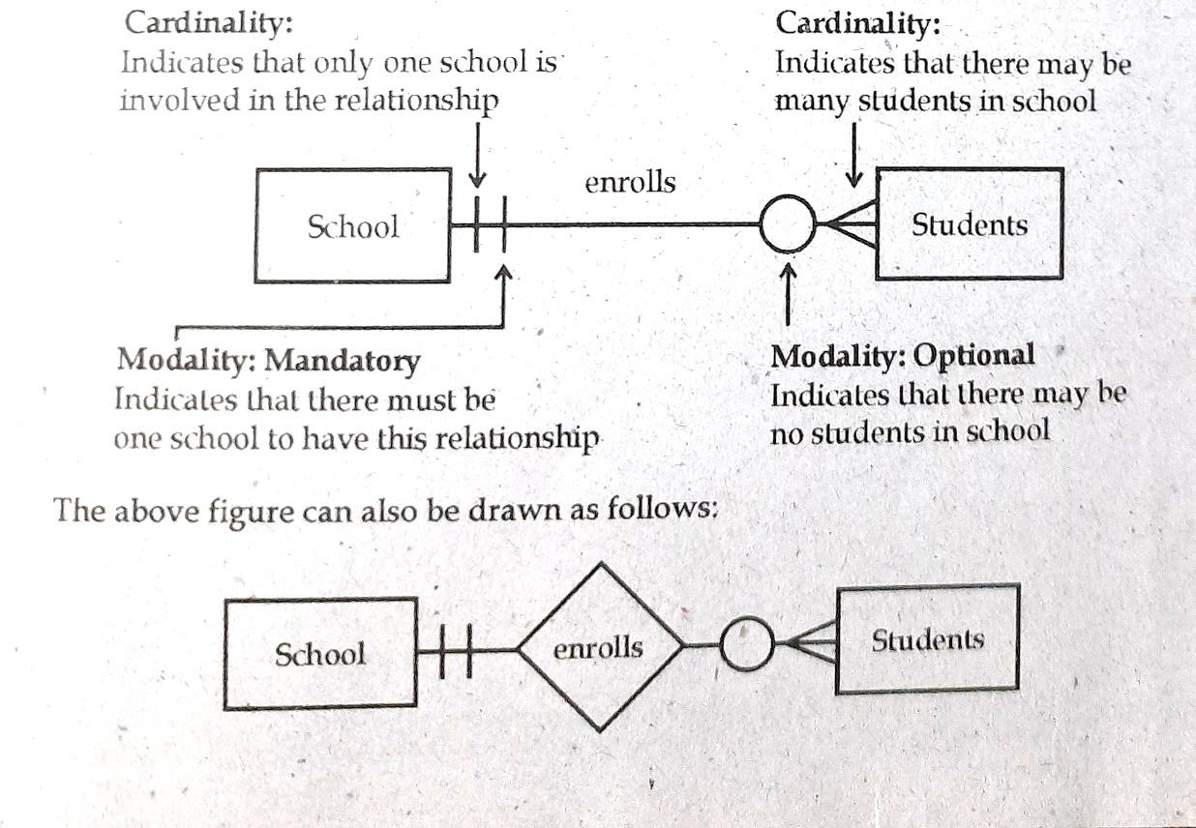
Cardinality and Modality

Slide 22
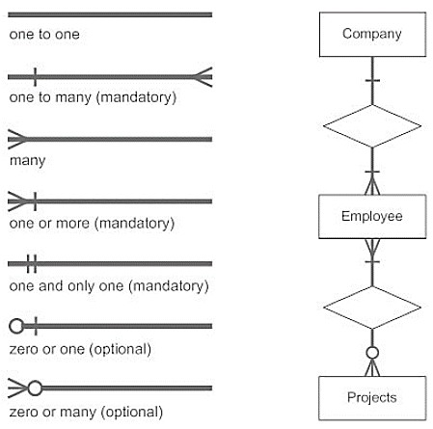
Database can be represented using the notations. In ER diagram, many notations are used to express the cardinality.
These notations are as follows:
Notation of ER Diagram

Slide 23
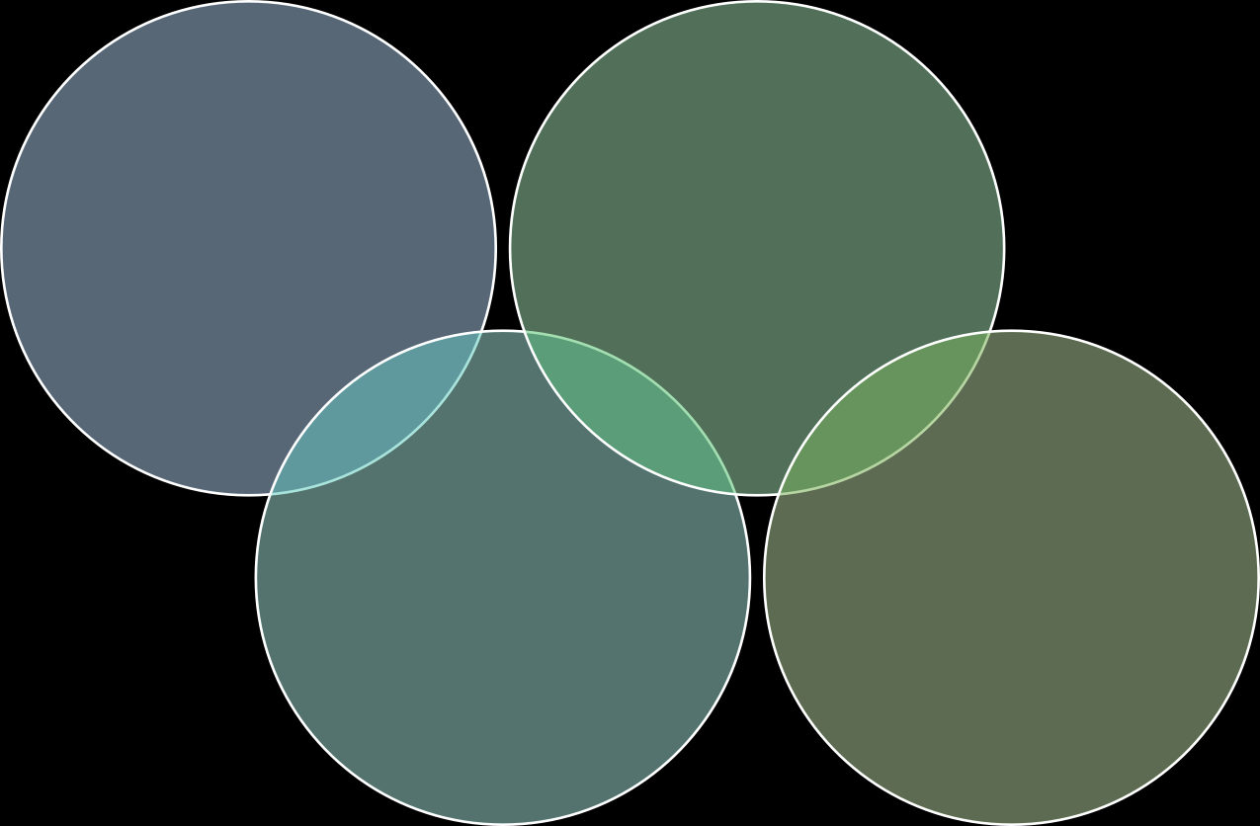
Use of Binary vs n-ary Relationship Sets
Use of Entity Set vs Attributes
ER Design Issues
Use of Entity
Set vs.
Relationship Sets
Placing Relationship Attributes

Slide 24
The use of an entity set or attribute depends on the structure of the real- world enterprise that is being modelled and the semantics associated with its attributes.
It leads to a mistake when the user use the primary key of an entity set as an attribute of another entity set.
Instead, he should use the relationship to do so.
Also, the primary key attributes are implicit in the relationship set, but we designate it in the relationship sets.
ER Design Issues Use of Entity Set vs Attributes

Slide 25
It is difficult to examine if an object can be best expressed by an entity set or relationship set.
To understand and determine the right use, the user need to designate a relationship set for describing an action that occurs in-between the entities.
If there is a requirement of representing the object as a relationship set, then its better not to mix it with the entity set.
ER Design Issues Use of Entity Set vs. Relationship Sets

Slide 26
Generally, the relationships described in the databases are binary relationships. However, non-binary relationships can be represented by several binary relationships.
For example, we can create and represent a ternary relationship 'parent' that may relate to a child, his father, as well as his mother.
Such relationship can also be represented by two binary relationships i.e, mother and father, that may relate to their child.
Thus, it is possible to represent a non- binary relationship by a set of distinct binary relationships.
ER Design Issues Use of Binary vs n-ary Relationship Sets

Slide 27
ER Design Issues Placing Relationship Attributes
The cardinality ratios can become an affective measure in the placement of the relationship attributes. So, it is better to associate the attributes of one-to-one or one-to-many relationship sets with any participating entity sets, instead of any relationship set.
The decision of placing the specified attribute as a relationship or entity attribute should possess the characteristics of the real-world enterprise that is being modelled.

Slide 28
ER Design Issues Placing Relationship Attributes
For example, if there is an entity which can be determined by the combination of participating entity sets, instead of determining it as a separate entity. Such type of attribute must be associated with the many-to-many relationship sets.
Thus, it requires the overall knowledge of each part that is involved in designing and modelling an ER diagram. The basic requirement is to analyze the real-world enterprise and the connectivity of one entity or attribute with other.

